Slide 1

Operating Systems
Lecture 38
Syed Mansoor Sarwar

Slide 2
Agenda for Today
Review of previous lecture
Performance of Demand Paging
Process Creation
Memory Mapped Files

Slide 3
Review of Lecture 37
Memory Management in Intel 80386
Virtual Memory Concept
Hardware Support
Demand Paging
Page Fault
Performance of Demand Paging

Slide 4
Intel 80386 Example
16-bit Selector
32-bit Offset
13-bit Segment #
s
g
p
2-bit field for specifying the privilege level
1-bit field to specify GDT or LDT

Slide 5

Intel 80386 Example

Slide 6

Demand Paging

Slide 7

Servicing a Page Fault

Slide 8
Block/String Move
0
1
Destination String
Source String
2
3
…

Slide 9
Performance of Demand Paging
Effective Access Time (EAT)
EAT = (1 – p) x memory access time
+ p (page fault service time)

Slide 10
Example
Memory access time = 100 nanosec
Page fault service time = 25 millisec
T_{effective} = (1 - p) x 100 + p (25 milli)
= (1 - p) x 100 + p (25000000)
= 100 + 24999900 x p
If one access out of 1000 causes a page fault, effective access time is 25 microseconds, a slowdown by a factor of 250.

Slide 11
Example
If we want less than 10 percentage degradation in effective memory access time then we have the following inequality
110 > 100 + 25000000 x p
10 > 25000000 x p
p < 0.0000004
This means we can allow only one page fault every 2,500,000.

Slide 12
Page Fault and No Free Frame
Page Replacement
  Replacement algorithm (minimize number of page faults)
  Performance with replacement
  Victim selection
    Criteria
    Local vs. global

Slide 13
Another Example
Effective memory access is 100 ns
Page fault overhead is 100 microseconds = 10⁵ ns
Page swap time is10 milliseconds = 10⁷ ns
50% of the time the page to be replaced is “dirty”
Restart overhead is 20 microseconds = 2 x 10⁴ ns

Slide 14
Another Example
Effective access time =
100 x (1-p) + (10⁵ + 2 x 10⁴
+ 0.5 x 10⁷ + 0.5 x 2 x 10⁷ ) x p
= 100 x (1-p) + 15,120,000 x p

Slide 15
What is a Good Page Fault Rate?
For the previous example suppose p is 1%, then EAT is
= 100 x (1-p) + 15,120,000 x p
= 151299 ns
⇒ a slowdown of 151299 / 100 = 1513

Slide 16
What is a Good Page Fault Rate?
For the luxury of virtual memory to cost only 20% overhead, we need
120 > 100 x (1-p) + 15,120,000 x p
120 > 100 -100 p + 15,120,000 p
p < 0.00000132
⇒ Less than one page fault for every 755995 memory accesses!

Slide 17
Process Creation
fork()
  Exact copy of parent’s memory image
  Copying parent’s pages (address space)
Child may call exec() immediately ⇒ copying parent’s address space is not needed

Slide 18
Process Creation
“Copy-on-write” ⇒ child share’s parent’s address space and pages which may change are marked “copy-on-write”
When a process tries to modify a page, it is copied and inserted in the page table for the process
Used in Windows 2000, Solaris 2, and Linux

Slide 19
Process Creation
vfork()
Parent is suspended and child uses parent’s address space
Pages altered by the child process are visible to parent
Intended to be used when child process calls exec() immediately after its creation

Slide 20
Linux Implementation
Shared pages are marked readonly after fork()
If either process tries to modify a shared page, a page fault occurs and the page is copied.
The other process (who later faults on write) discovers it is the only owner; so no copying takes place.

Slide 21
Memory-Mapped Files
Memory-mapped file I/O allows file I/O to be treated as routine memory access by mapping a disk block to a page in memory.
A file is initially read using demand paging. A page-sized portion of the file is read from the file system into a physical page. Subsequent reads/writes from/to the file are treated as ordinary memory accesses.

Slide 22
Memory-Mapped Files
Simplifies file access by treating file I/O through memory rather than read() write() system calls.
Also allows several processes to map the same file allowing the pages in memory to be shared.
Some operating systems only provide memory-mapping through a system call (mmap()). Others treat all file I/O as memory mapped files.

Slide 23
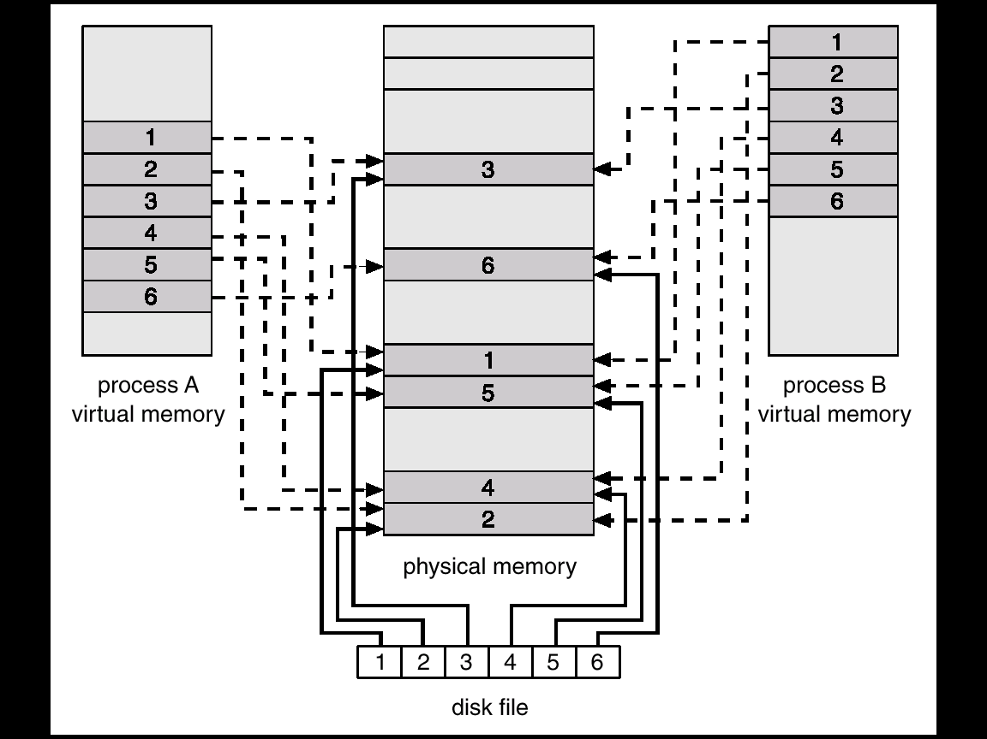
Memory-Mapped Files

Slide 24
mmap() System Call
“Normal” File I/O
fildes = open(...);
lseek(...);
read(fildes, buf, len);
/* use data in buf */
File I/O with mmap()
fildes = open(...)
address = mmap((caddr_t) 0, len,(PROT_READ | PROT_WRITE), MAP_PRIVATE, fildes, offset);
/* use data at address */

Slide 25
Memory-Mapped Files in Solaris 2
If file is opened as memory mapped: it maps the file to the address space of the process.
If the file is opened non memory-mapped, Solaris 2 opens it as a memory-mapped file, mapping it to the kernel address space

Slide 26
Recap of Lecture
Performance of Demand Paging
Process Creation
Memory Mapped Files

Slide 27
Operating Systems
Lecture 38
Syed Mansoor Sarwar

